Slide 1

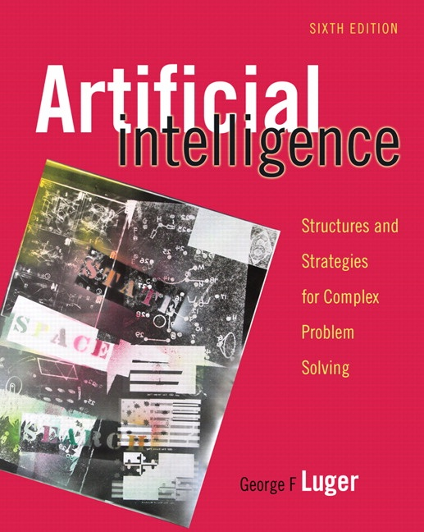
Strong Method Problem Solving.
8.0 Introduction
8.1 Overview of Expert System
Technology
8.2 Rule-Based Expert Systems
8.3 Model-Based, Case-Based and Hybrid Systems
8.4 Planning
8.5 Epilogue and References
8.6 Exercises
George F Luger
ARTIFICIAL INTELLIGENCE 6th edition
Structures and Strategies for Complex Problem Solving
Luger: Artificial Intelligence, 6th edition. © Pearson Education Limited, 2009
1

Slide 2
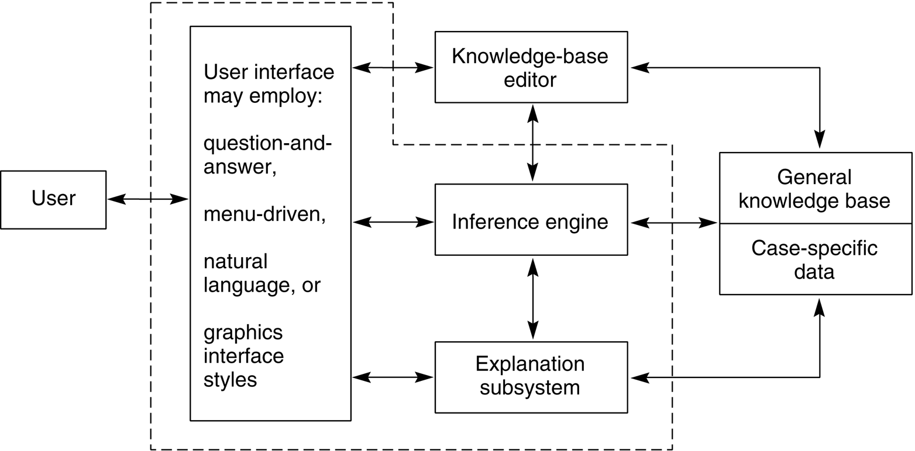
Fig 8.1 architecture of a typical expert system for a particular problem domain.
Luger: Artificial Intelligence, 6th edition. © Pearson Education Limited, 2009
2

Slide 3
Guidelines to determine whether a problem is appropriate for expert system solution:
1. The need for the solution justifies the cost and effort of building an expert system.
2. Human expertise is not available in all situations where it is needed.
3. The problem may be solved using symbolic reasoning.
4. The problem domain is well structured and does not require commonsense reasoning.
5. The problem may not be solved using traditional computing methods.
6. Cooperative and articulate experts exist.
7. The problem is of proper size and scope.
Luger: Artificial Intelligence, 6th edition. © Pearson Education Limited, 2009
3

Slide 4
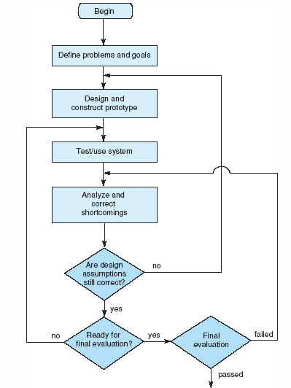
Fig 8.2 Exploratory development cycle.
Luger: Artificial Intelligence, 6th edition. © Pearson Education Limited, 2009
4

Slide 5
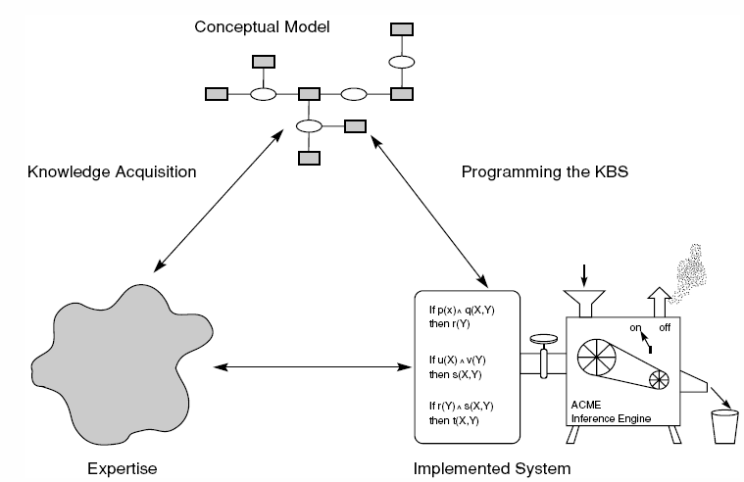
Fig 8.4 The role of mental or conceptual models in problem solving.
Luger: Artificial Intelligence, 6th edition. © Pearson Education Limited, 2009
5

Slide 6
A small expert system for analysis of automotive problems.
Rule 1: if
the engine is getting gas, and
the engine will turn over,
then
the problem is spark plugs.
Rule 2: if
the engine does not turn over, and
the lights do not come on
then
the problem is battery or cables.
Rule 3: if
the engine does not turn over, and
the lights do come on
then
the problem is the starter motor.
Rule 4: if
there is gas in the fuel tank, and
there is gas in the carburetor
then
the engine is getting gas.
Luger: Artificial Intelligence, 6th edition. © Pearson Education Limited, 2009
6

Slide 7
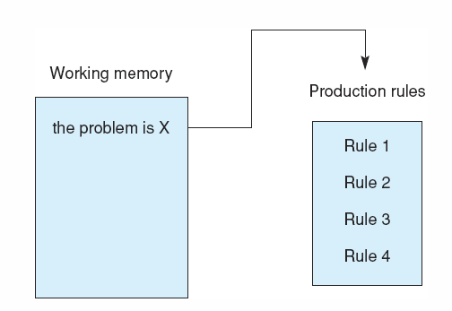
Fig 8.5 The production system at the start of a consultation in the car diagnostic example.
Luger: Artificial Intelligence, 6th edition. © Pearson Education Limited, 2009
7

Slide 8
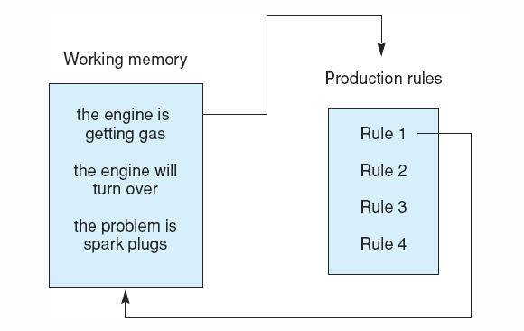
Fig 8.6 The production system after Rule 1 has fired.
Luger: Artificial Intelligence, 6th edition. © Pearson Education Limited, 2009
8

Slide 9
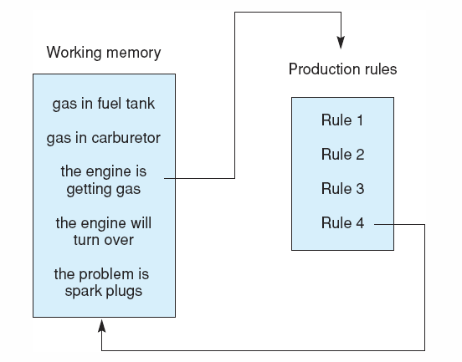
Fig 8.7 The system after Rule 4 has fired. Note the stack-based approach to goal reduction.
Luger: Artificial Intelligence, 6th edition. © Pearson Education Limited, 2009
9

Slide 10
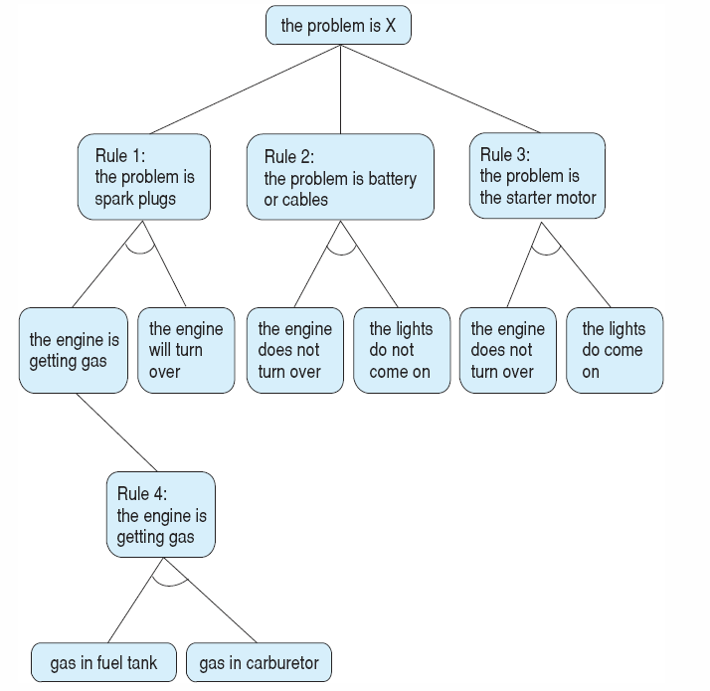
Fig 8.8 The and/or graph searched in the car diagnosis example, with the conclusion of Rule 4 matching the first premise of Rule 1.
Luger: Artificial Intelligence, 6th edition. © Pearson Education Limited, 2009
10

Slide 11
The following dialogue begins with the computer asking the user about the goals present in working memory.
Gas in fuel tank?
Yes
Gas in carburetor?
Yes
Engine will turn over?
Why
It has been established that:
1. The engine is getting gas,
2. The engine will turn over,
Then the problem is the spark plugs.
How the engine is getting gas
This follows from rule 4:
if
gas in fuel tank, and
gas in carburetor
then
engine is getting gas.
gas in fuel tank was given by the user
gas in carburetor was given by the user
Luger: Artificial Intelligence, 6th edition. © Pearson Education Limited, 2009
11

Slide 12
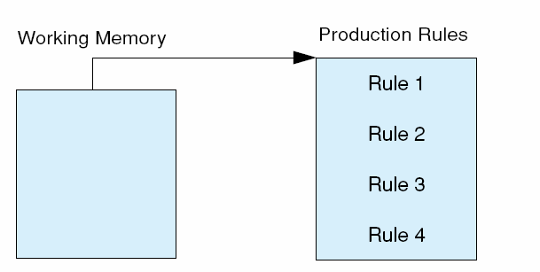
Fig 8.9 The production system at the start of a consultation for data-driven reasoning.
Luger: Artificial Intelligence, 6th edition. © Pearson Education Limited, 2009
12

Slide 13
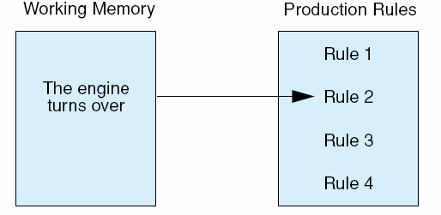
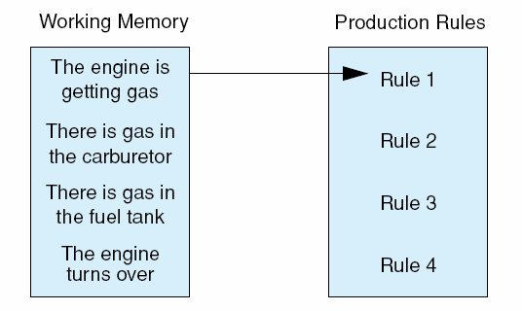
Fig 8.10 The production system after evaluating the first premise of Rule 2, which then fails.
Fig 8.11 The data-driven production system after considering Rule 4, beginning its second pass through the rules.
Luger: Artificial Intelligence, 6th edition. © Pearson Education Limited, 2009
13

Slide 14
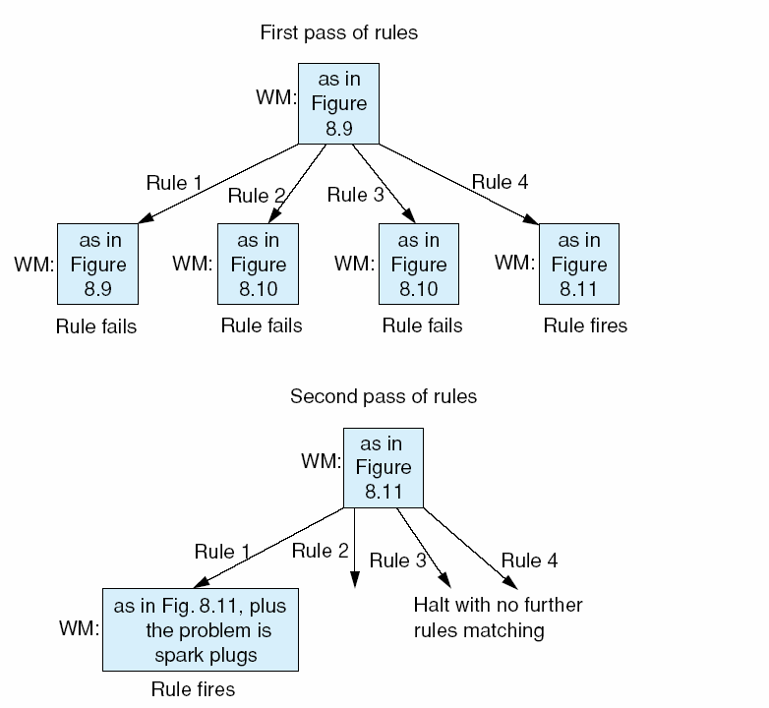
Fig 8.12 The search graph as described by the contents of working memory (WM) for the data-driven breadth-first search of the rule set of Section 8.2.1
Luger: Artificial Intelligence, 6th edition. © Pearson Education Limited, 2009
14

Slide 15
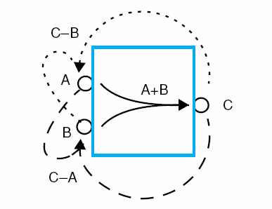
Fig 8.13 The behavior description of an adder after Davis and Hamscher (1992)
Luger: Artificial Intelligence, 6th edition. © Pearson Education Limited, 2009
15

Slide 16
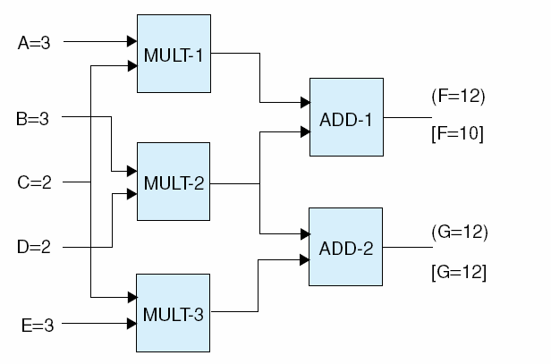
Fig 8.14 Taking advantage of direction of information flow, after Davis and Hamscher (1992).
Luger: Artificial Intelligence, 6th edition. © Pearson Education Limited, 2009
16

Slide 17
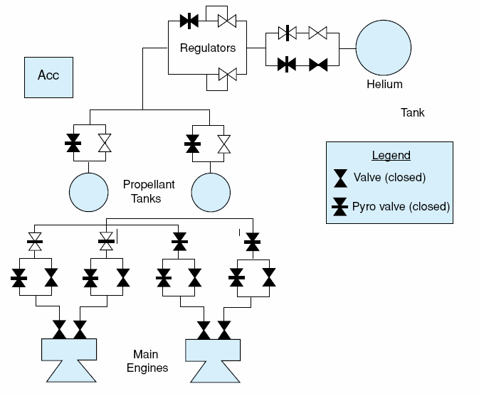
Fig 8.15 A schematic of the simplified Livingstone propulsion system, from Williams and Nayak (1996b).
Luger: Artificial Intelligence, 6th edition. © Pearson Education Limited, 2009
17

Slide 18
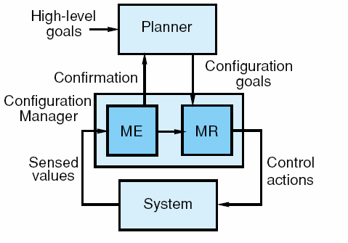
Fig 8.16 a model-based configuration management system, from Williams and Nayak (1996b).
Luger: Artificial Intelligence, 6th edition. © Pearson Education Limited, 2009
18

Slide 19
Case-based reasoners share a common structure. For each new problem they:
1. Retrieve appropriate cases from memory.
2. Modify a retrieved case so that it will apply to the current situation.
3. Apply the transformed case.
4. Save the solution, with a record of success or failure, for future use.
Luger: Artificial Intelligence, 6th edition. © Pearson Education Limited, 2009
19

Slide 20
Kolodner (1993) offers a set of possible preference heuristics to help organize the storage and retrieval of cases. These include:
1. Goal-directed preference. Organize cases, at least in part, by
goal descriptions. Retrieve cases that have the same goal as the
current situation.
2. Salient-feature preference. Prefer cases that match the most
important features or those matching the largest number of
important features.
3. Specify preference. Look for as exact as possible matches of
features before considering more general matches.
4. Frequency preference. Check first the most frequently matched
cases.
5. Recency preference. Prefer cases used most recently.
6. Ease of adaptation preference. Use first cases most easily
adapted to the current situation.
Luger: Artificial Intelligence, 6th edition. © Pearson Education Limited, 2009
20

Slide 21
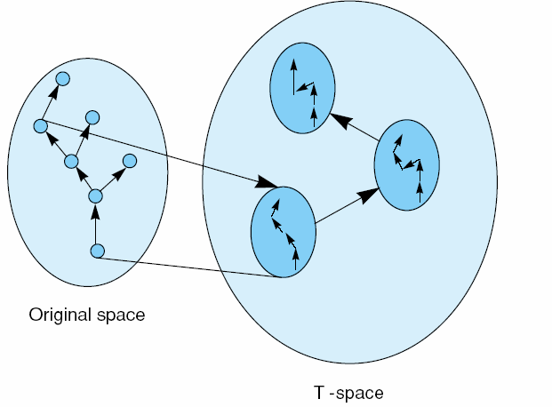
Fig 8.17 Transformational analogy, adapted from Carbonell (1983).
Luger: Artificial Intelligence, 6th edition. © Pearson Education Limited, 2009
21

Slide 22
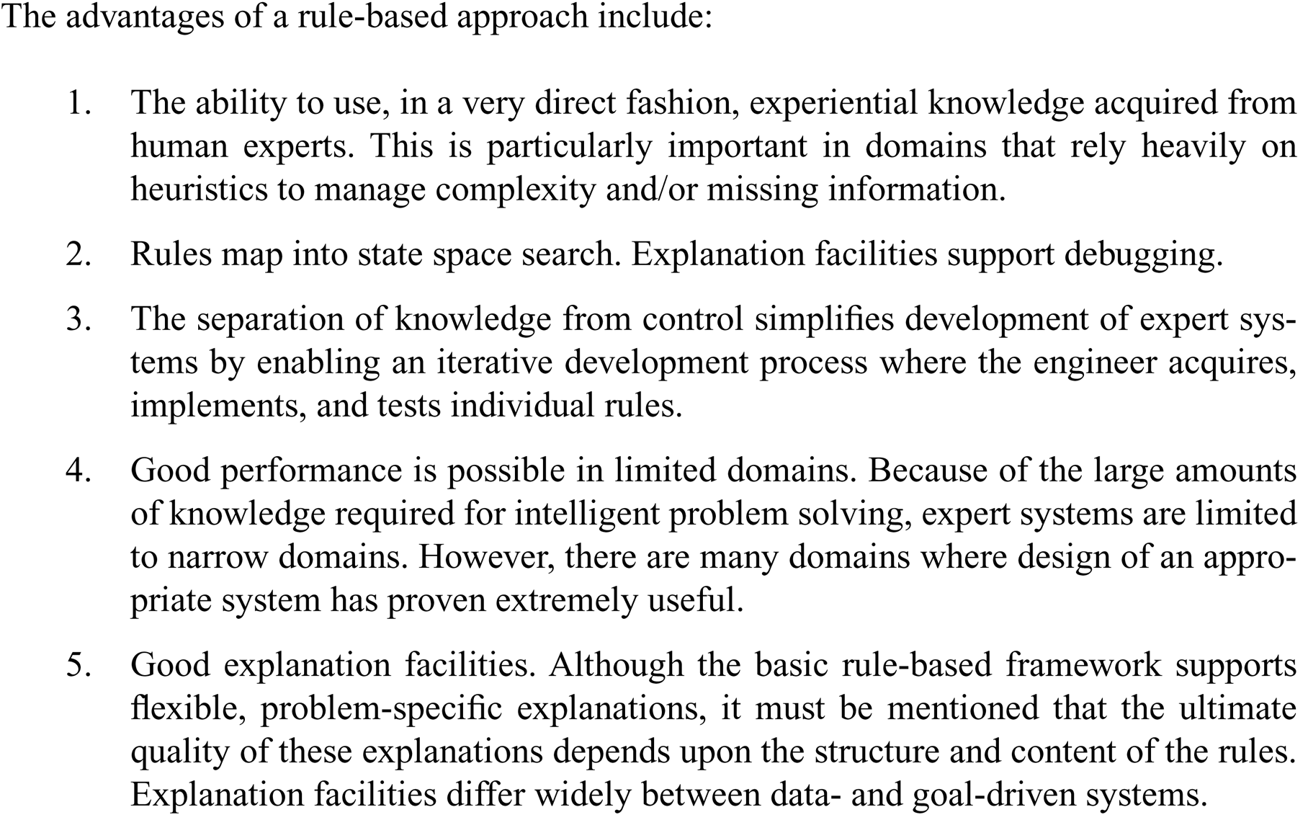
Luger: Artificial Intelligence, 6th edition. © Pearson Education Limited, 2009
22

Slide 23
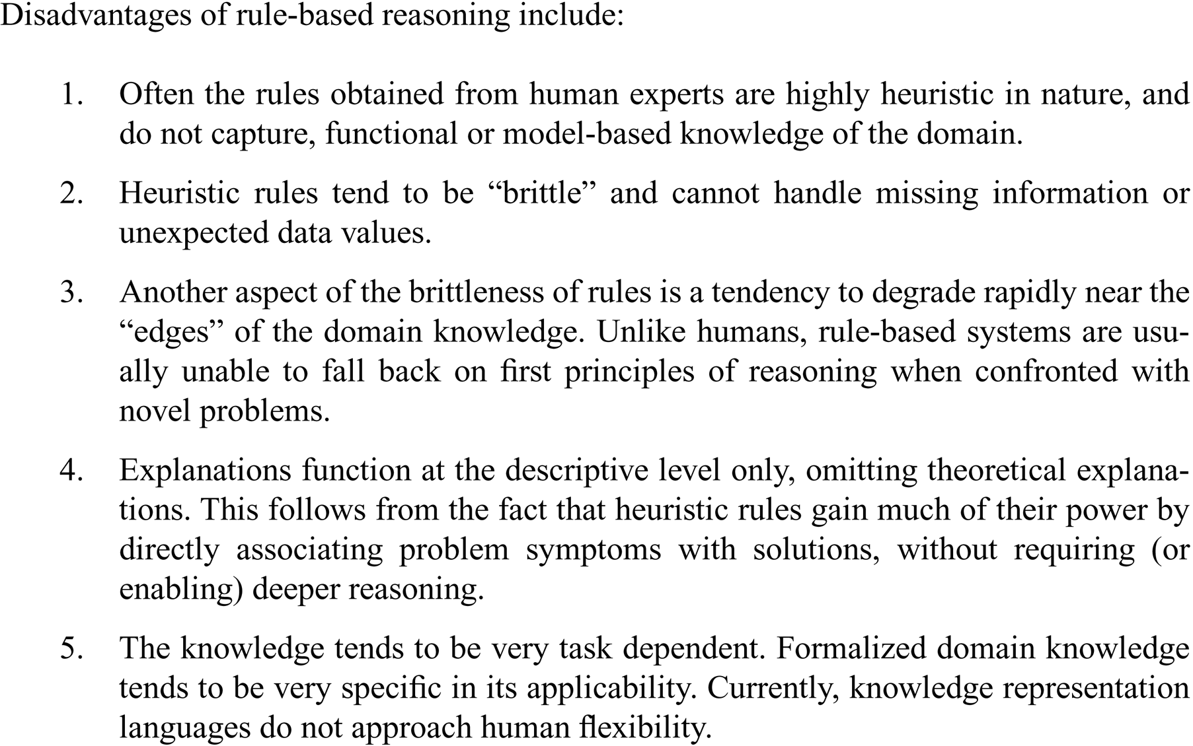
Luger: Artificial Intelligence, 6th edition. © Pearson Education Limited, 2009
23

Slide 24
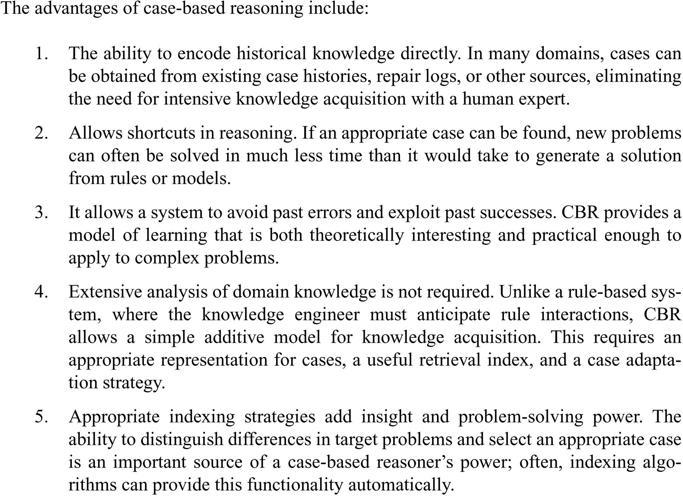
Luger: Artificial Intelligence, 6th edition. © Pearson Education Limited, 2009
24

Slide 25
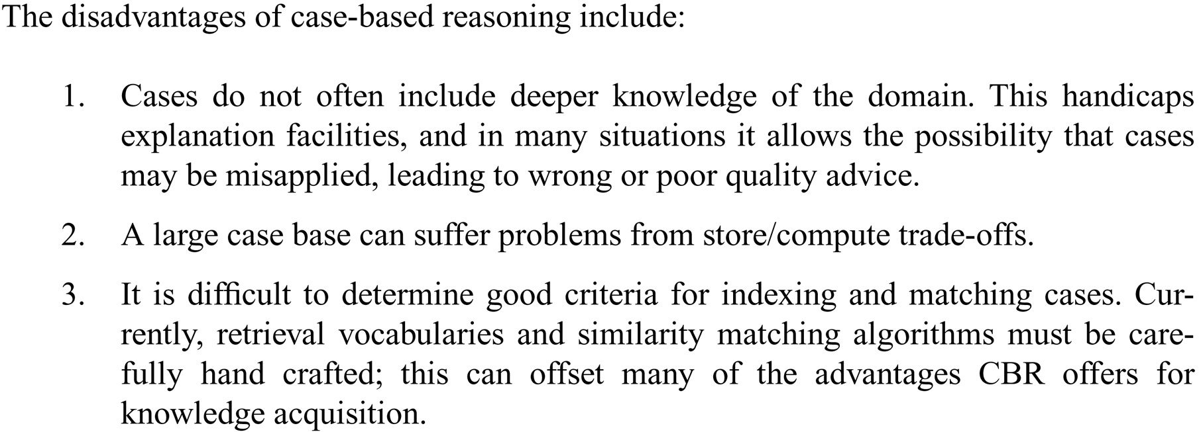
Luger: Artificial Intelligence, 6th edition. © Pearson Education Limited, 2009
25

Slide 26
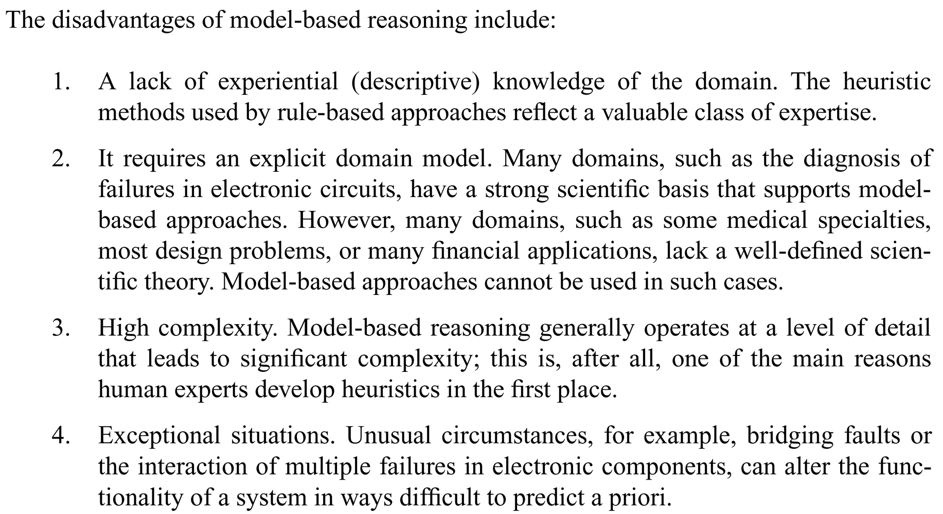
Luger: Artificial Intelligence, 6th edition. © Pearson Education Limited, 2009
26

Slide 27
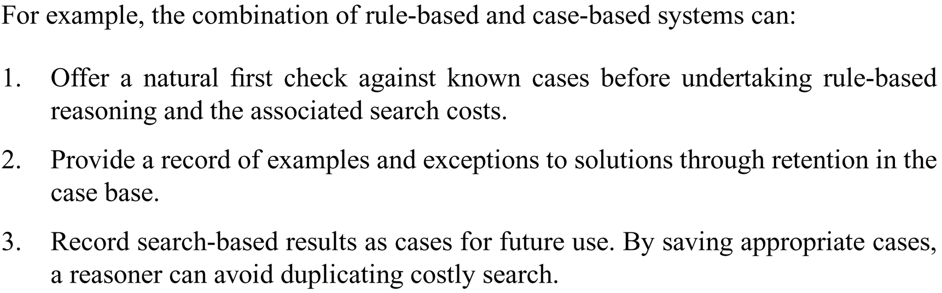
Luger: Artificial Intelligence, 6th edition. © Pearson Education Limited, 2009
27

Slide 28
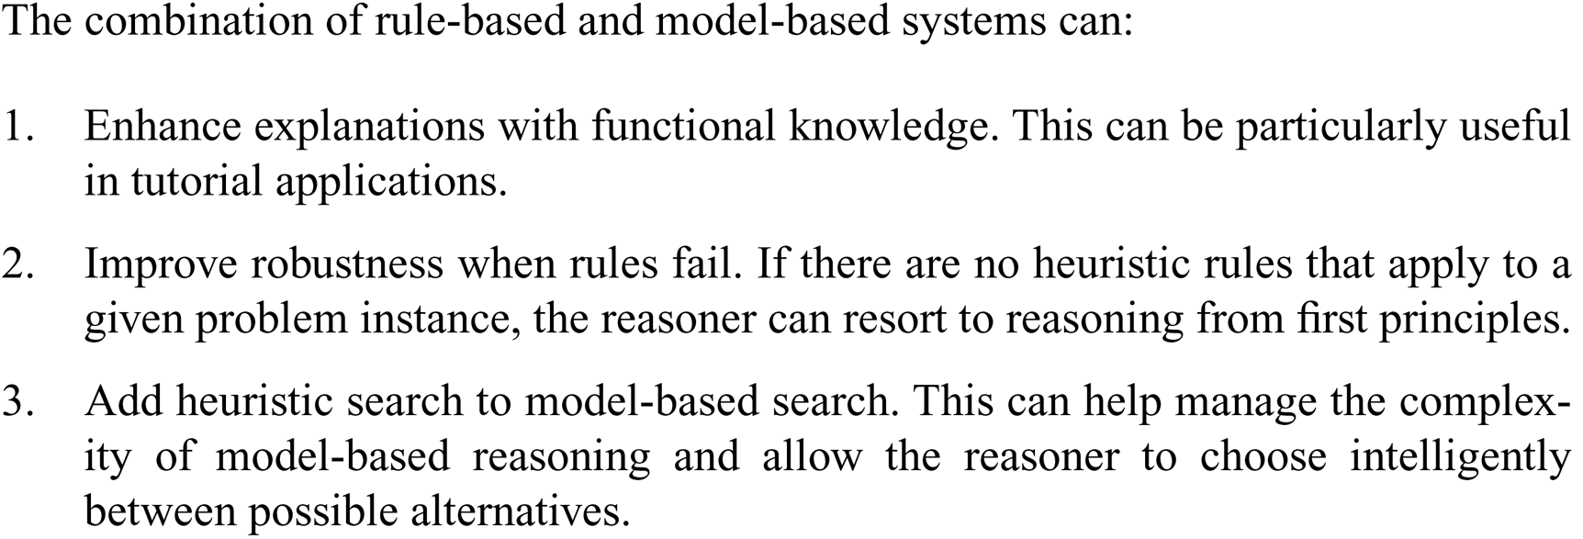
Luger: Artificial Intelligence, 6th edition. © Pearson Education Limited, 2009
28

Slide 29
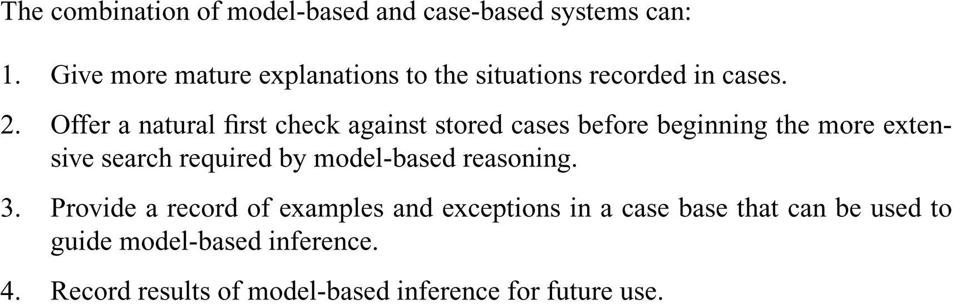
Luger: Artificial Intelligence, 6th edition. © Pearson Education Limited, 2009
29

Slide 30
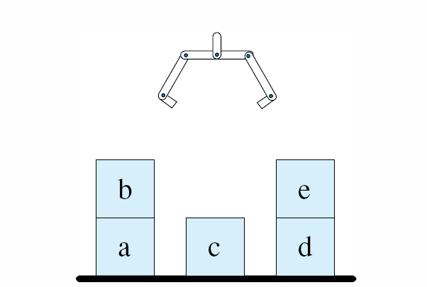
Fig 8.18 The blocks world.
Luger: Artificial Intelligence, 6th edition. © Pearson Education Limited, 2009
30

Slide 31
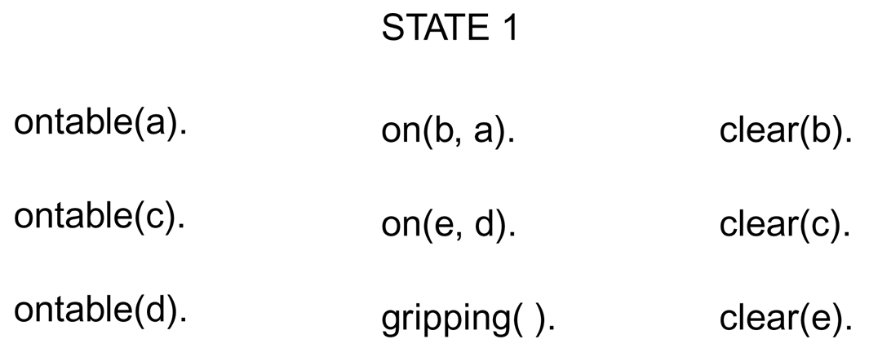
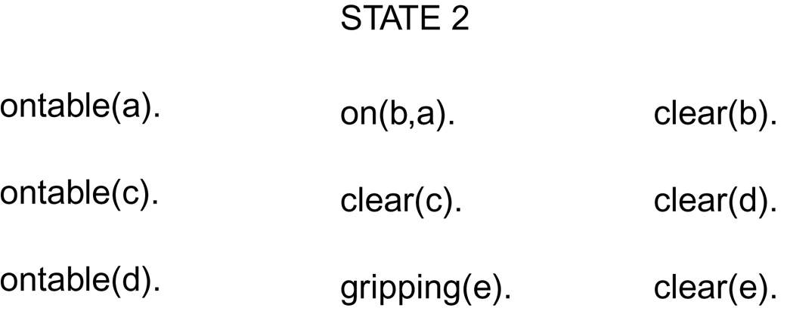
The blocks world of figure 8.18 may now be represented by the following set of predicates.
Luger: Artificial Intelligence, 6th edition. © Pearson Education Limited, 2009
31

Slide 32
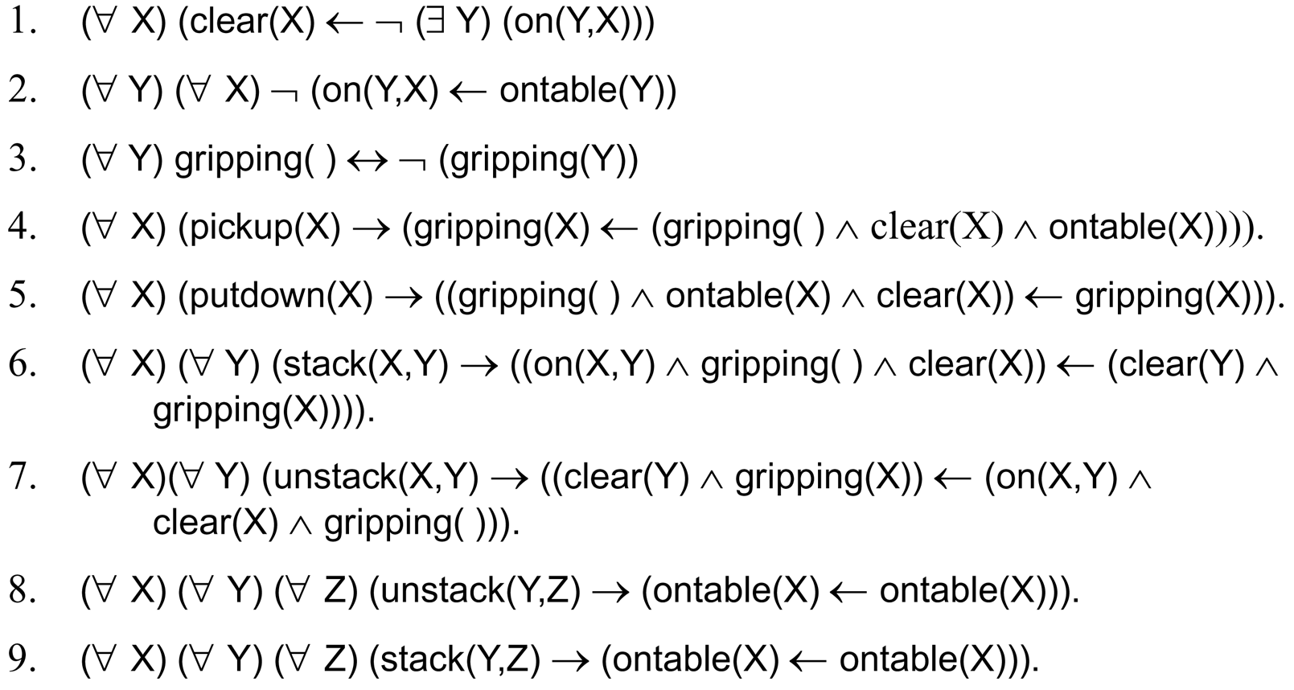
A number of truth relations or rules for performance are created for the clear (X), ontable (X), and gripping ().
Luger: Artificial Intelligence, 6th edition. © Pearson Education Limited, 2009
32

Slide 33
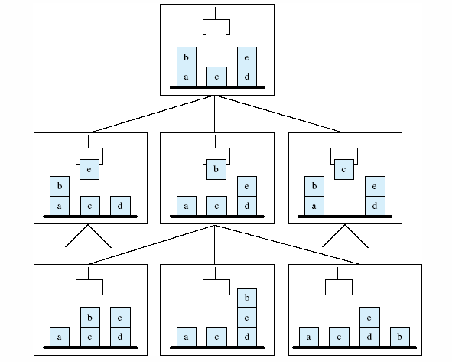
Fig 8.19 Portion of the state space for a portion of the blocks world.
Luger: Artificial Intelligence, 6th edition. © Pearson Education Limited, 2009
33

Slide 34
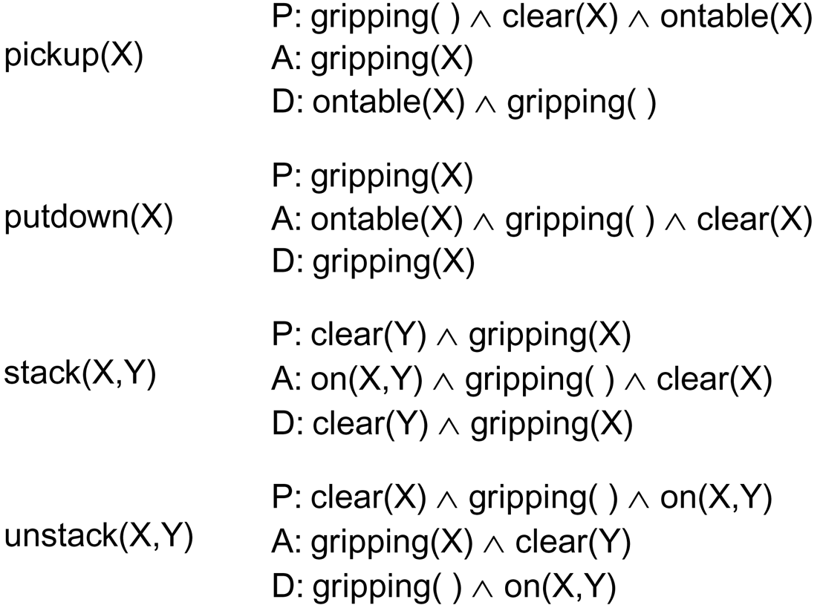
Using blocks example, the four operators pickup, putdown, stack, and unstack are represented as triples of descriptions.
Luger: Artificial Intelligence, 6th edition. © Pearson Education Limited, 2009
34

Slide 35
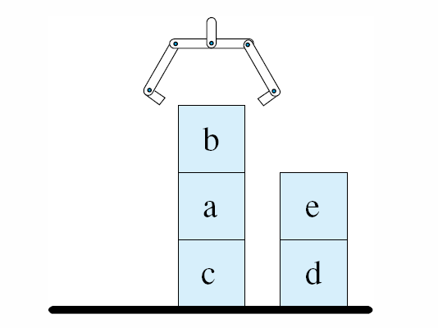
Fig 8.20 Goal state for the blocks world.
Luger: Artificial Intelligence, 6th edition. © Pearson Education Limited, 2009
35

Slide 36
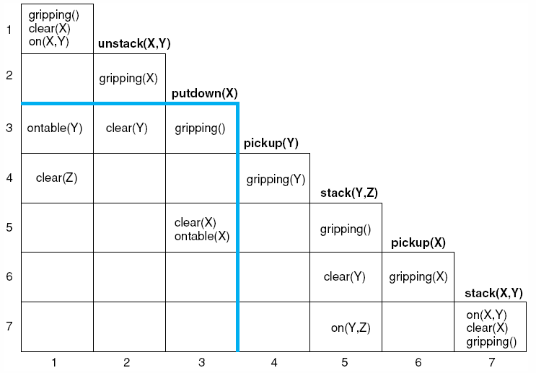
Fig 8.21 A triangle table, adapted from Nilsson (1971).
Luger: Artificial Intelligence, 6th edition. © Pearson Education Limited, 2009
36

Slide 37
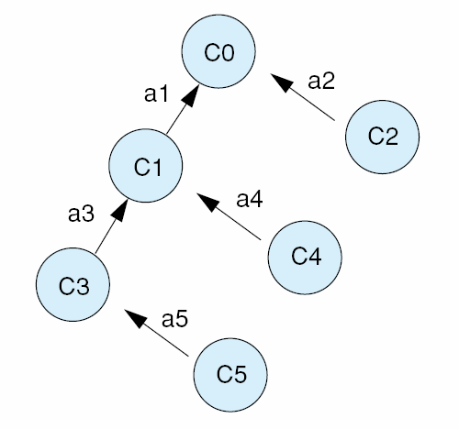
Fig 8.22 A simple TR tree showing condition action rules supporting a top-level goal, from Klein et al. (2000).
Luger: Artificial Intelligence, 6th edition. © Pearson Education Limited, 2009
37

Slide 38
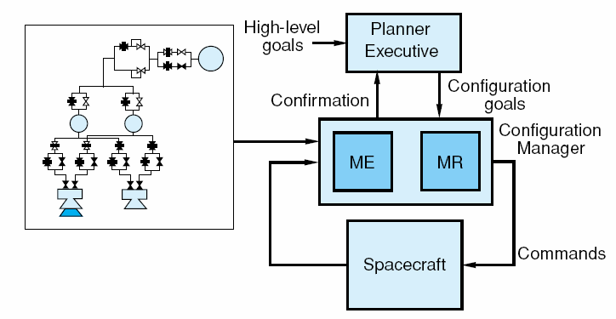
Fig 8.23 Model-based reactive configuration management, from Williams and Nayak (1996b).
Luger: Artificial Intelligence, 6th edition. © Pearson Education Limited, 2009
38

Slide 39
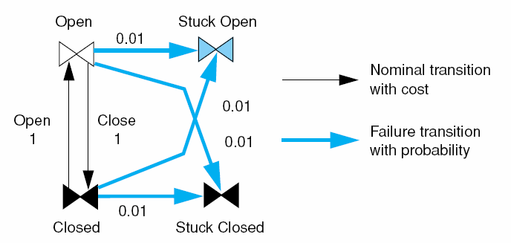
Fig 8.24 The transition system model of a valve, from Williams and Nayak (1996a).
Luger: Artificial Intelligence, 6th edition. © Pearson Education Limited, 2009
39

Slide 40
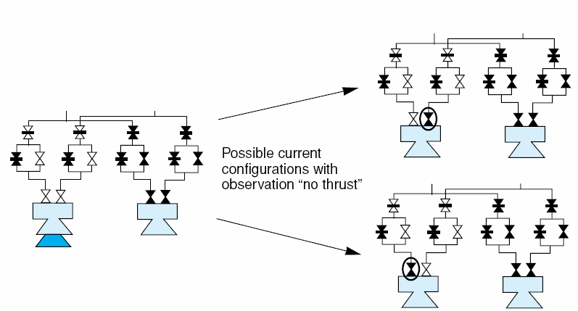
Fig 8.25 Mode estimation (ME), from Williams and Nayak (1996a).
Luger: Artificial Intelligence, 6th edition. © Pearson Education Limited, 2009
40

Slide 41
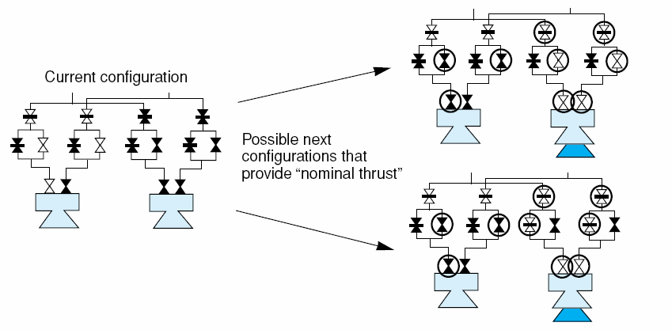
Fig 8.26 Mode reconfiguration (MR), from Williams and Nayak (1996a).
Luger: Artificial Intelligence, 6th edition. © Pearson Education Limited, 2009
41

